Slide 1
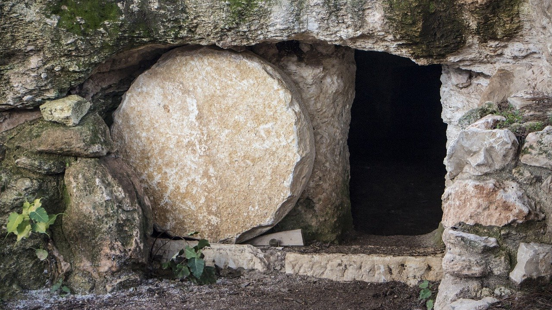
A Surprising Narrative of Resurrection John 11:1-44
April 20, 2025

Slide 2
Galatians 2:20
I have been crucified with Christ; and it is no longer I who live, but Christ lives in me; and the life which I now live in the flesh I live by faith in the Son of God, who loved me and gave Himself up for me.

Slide 3
Hebrews 9:27
And inasmuch as it is appointed for men to die once and after this comes judgment…

Slide 4
Ecclesiastes 7:2
It is better to go to a house of mourning Than to go to a house of feasting, Because that is the end of every man, And the living takes it to heart.

Slide 5
1 Corinthians 15:16-19
16 For if the dead are not raised, not even Christ has been raised; 17 and if Christ has not been raised, your faith is worthless; you are still in your sins. 18 Then those also who have fallen asleep in Christ have perished. 19 If we have hoped in Christ in this life only, we are of all men most to be pitied.

Slide 6
John 11:25-26
25 Jesus said to her, “I am the resurrection and the life; he who believes in Me will live even if he dies, 26 and everyone who lives and believes in Me will never die.”

Slide 7
A Surprising Narrative of Resurrection
The surprising procrastination of Christ ^{(11:1-16)}
The surprising promises of Christ ^{(11:17-27)}

Slide 8
Job 19:25-27 (about 2200 BC)
25 As for me, I know that my Redeemer lives, And at the last He will take His stand on the earth. 26 Even after my skin is destroyed, Yet from my flesh I shall see God; 27 Whom I myself shall behold, And whom my eyes will see and not another. My heart faints within me!

Slide 9
Isaiah 26:19 (about 700 BC)
Your dead will live; Their corpses will rise. You who lie in the dust, awake and shout for joy, For your dew is as the dew of the dawn, And the earth will give birth to the departed spirits.

Slide 10
John 6:38-40
38 For I have come down from heaven, not to do My own will, but the will of Him who sent Me. 39 This is the will of Him who sent Me, that of all that He has given Me I lose nothing, but raise it up on the last day. 40 For this is the will of My Father, that everyone who beholds the Son and believes in Him will have eternal life, and I Myself will raise him up on the last day.

Slide 11
The Seven “I am” Statements of Christ
I am the bread of life ^{(John 6:35)}
I am the light of the world ^{(John 8:12)}
I am the door of the sheep ^{(John 10:7)}
I am the good shepherd ^{(John 10:11)}
I am the resurrection and the life ^{(John 11:25)}
I am the way, the truth, and the life ^{(John 14:6)}
I am the true vine ^{(John 15:1)}

Slide 12
John 5:24
Truly, truly, I say to you, he who hears My word, and believes Him who sent Me, has eternal life, and does not come into judgment, but has passed out of death into life.

Slide 13
John 11:25-26
25 Jesus said to her, “I am the resurrection and the life; he who believes in Me will live even if he dies, 26 and everyone who lives and believes in Me will never die.”

Slide 14
A Surprising Narrative of Resurrection
The surprising procrastination of Christ ^{(11:1-16)}
The surprising promises of Christ ^{(11:17-27)}
The surprising passion of Christ ^{(11:28-38)}
The surprising power of Christ ^{(11:39-44)}
The surprising question of Christ
“Do you believe this?”

Slide 15
A Surprising Narrative of Resurrection John 11:1-44
April 20, 2025

